Slide 1
CALD LAB #3 Conditional statements in assembly language using VVM
ENGR.RAMSHA MASHOOD

Slide 2
BRP nn
Branch if Positive or Zero (8nn) [BRP nn]
This is a conditional branch instruction. If the value in the Accumulator Register is positive or zero, then the Program Counter Register is replaced by the operand value nn. The result is that the next instruction to be executed will be taken from address nn rather than from the next sequential address. Otherwise (Accumulator < 0), the Program Counter Register is incremented by one, and the next sequential instruction is executed.

Slide 3
BRZ nn
Branch if Zero (7nn) [BRZ nn]
This is a conditional branch instruction. If the value in the Accumulator Register is zero, then the Program Counter Register is replaced by the operand value nn. The result is that the next instruction to be executed will be taken from address nn rather than from the next sequential address. Otherwise (Accumulator <> 0), the Program Counter Register is incremented by one, and the next sequential instruction is executed.

Slide 4
BR nn
Branch (6nn) [BR nn] (or [BRU nn] or [JMP nn])
This is an unconditional branch instruction. The current value of the Program Counter Register is replaced by the operand value nn. The result is that the next instruction to be executed will be taken from address nn rather than from the next sequential address. The value of the Program Counter Register is not incremented with this instruction.

Slide 5
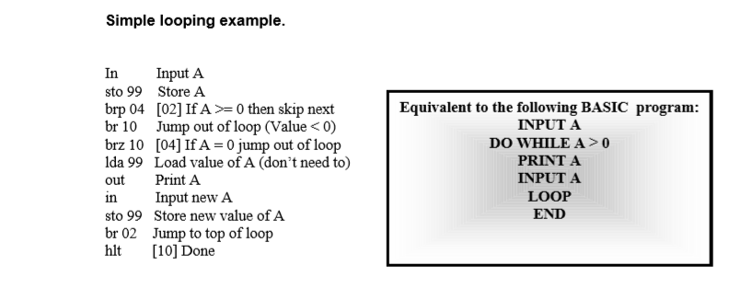
VVM PROGRAM 1

Slide 6
VVM PROGRAM 2
Write a program to print the square of any integer in the range 1-31.

Slide 7
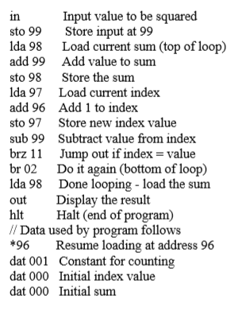
Solution of VVM Program 2

Slide 8
Lab Task
Write a VVM program which take an integer input and display table of that integer.

